Slide 1
Beautiful Bangladesh
Presented by Abu bakar

Slide 2
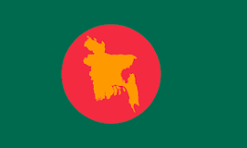
Independence
The Bangladesh Liberation War started on 26 March and lasted till 16 December 1971 which is celebrated as Victory Day in Bangladesh. In the early hours of March 26, 1971, the undisputed leader of Bengali, Sheikh Mujibur Rahman, declared independence before being arrested by the Pakistani army.

Slide 3
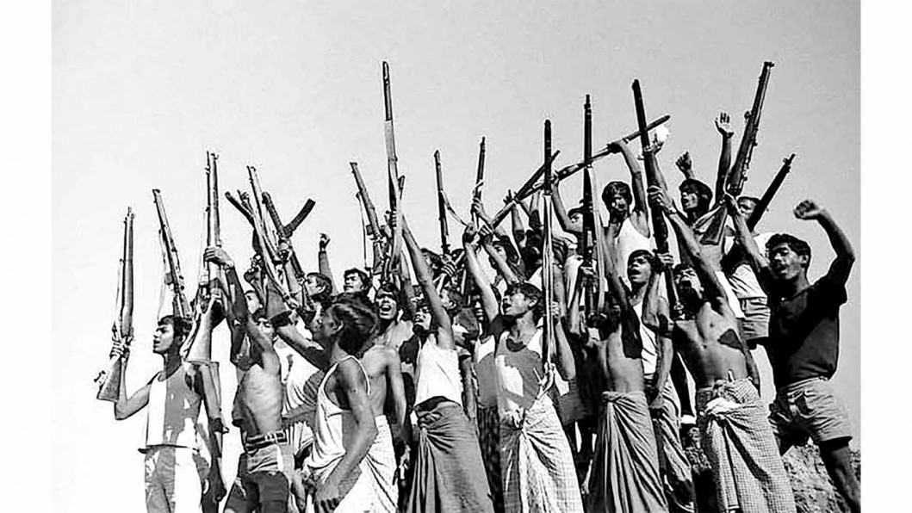
Liberation War
The war began after the Pakistani military junta based in West Pakistan launched Operation Searchlight against the people of East Pakistan on the night of 25 March 1971. It pursued the systematic elimination of nationalist Bengali civilians, students, intelligentsia, religious minorities and armed personnel.

Slide 4

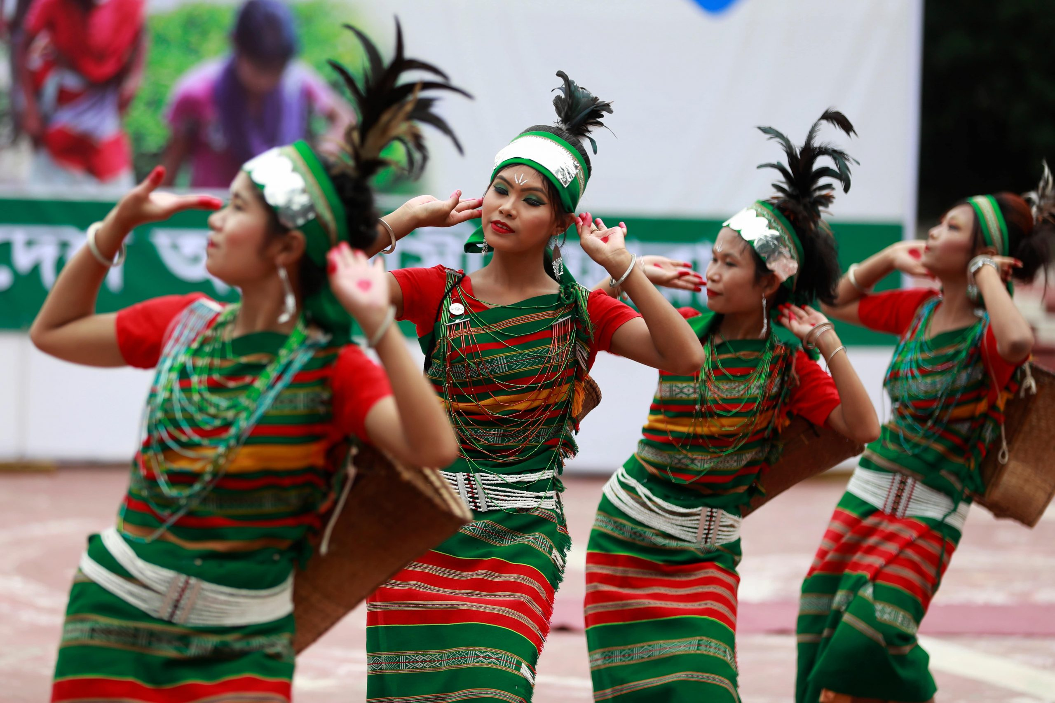
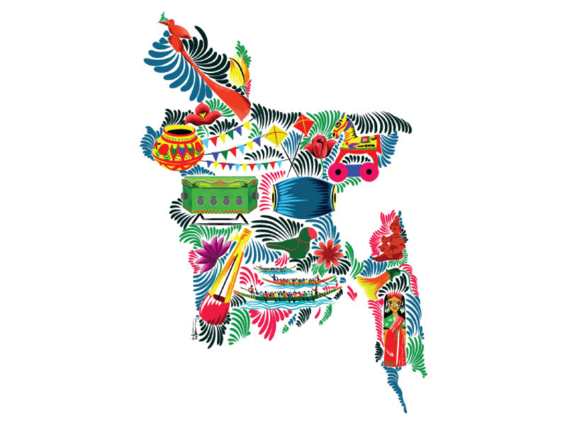
Cultuer of BD
The Bengal region has a multifaceted folk heritage, enriched by its ancient animist, Buddhist, Hindu, and Muslim roots. Weaving, pottery and terracotta sculpture are some of the earliest forms of artistic expression.

Slide 5
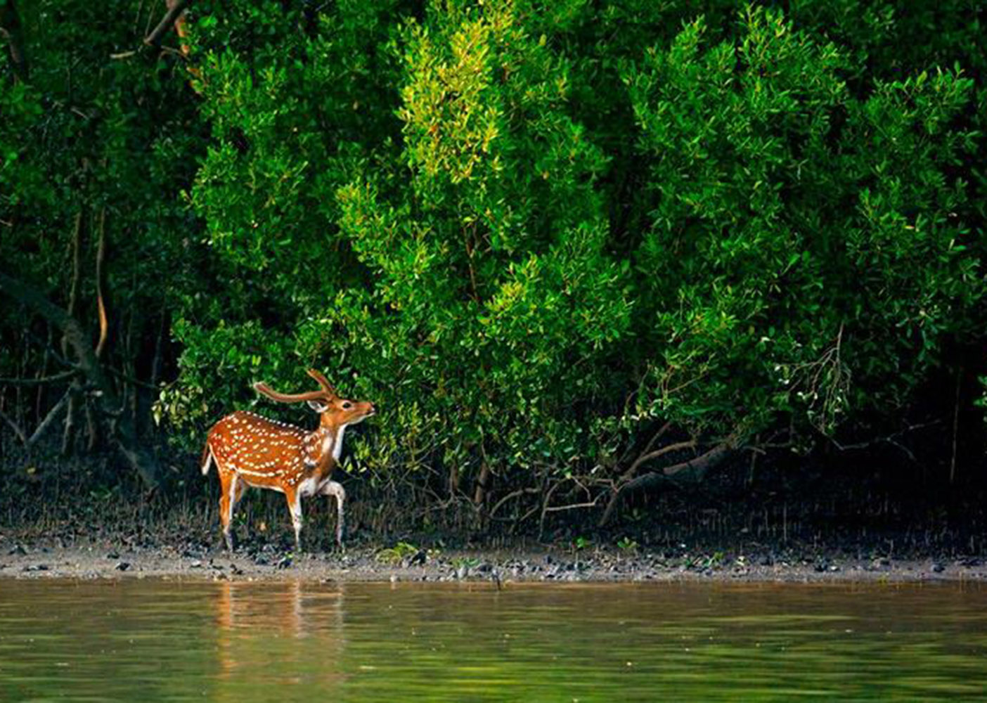
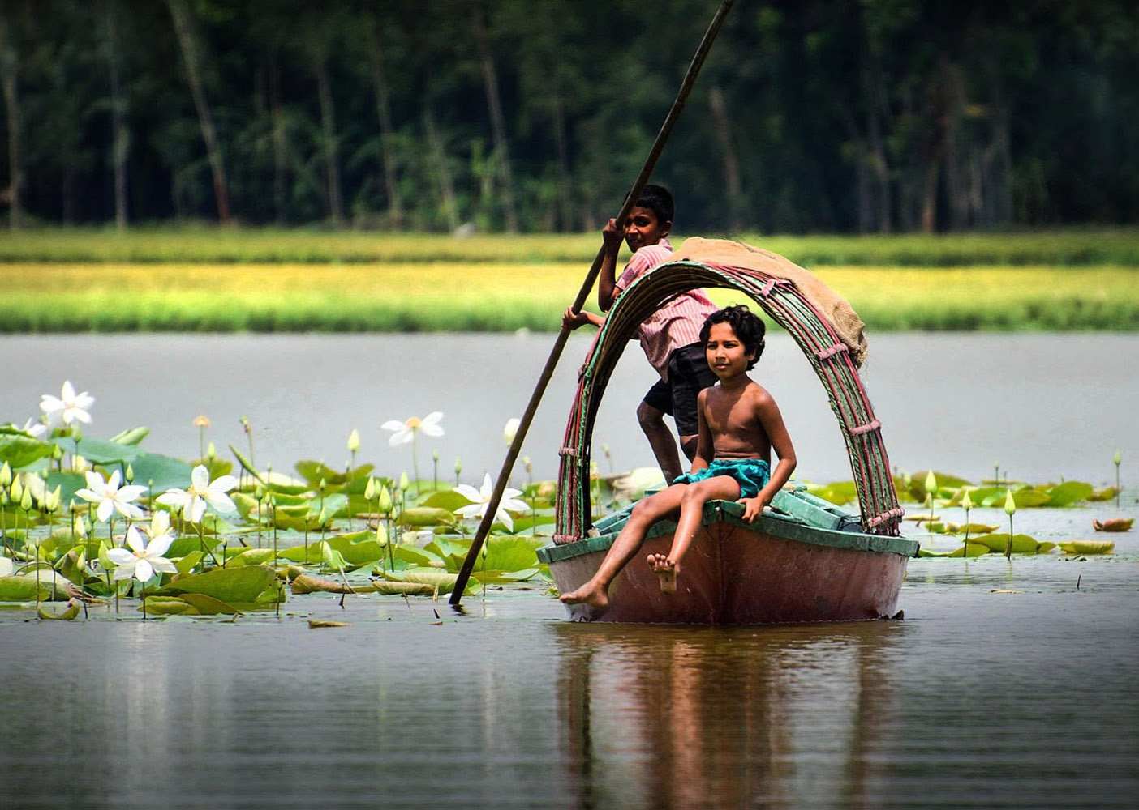
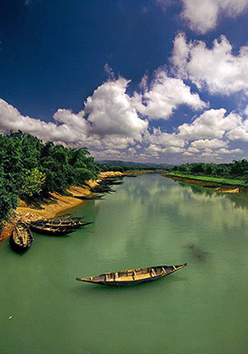
Beauty
Bangladesh has a land of enormous natural beauty, hundreds of rivers, crystal clear water, lakes surrounded by green hills, tropical rain forests, world's largest mangrove forest, home of the Royal Bengal Tiger and the wild lives

Slide 6
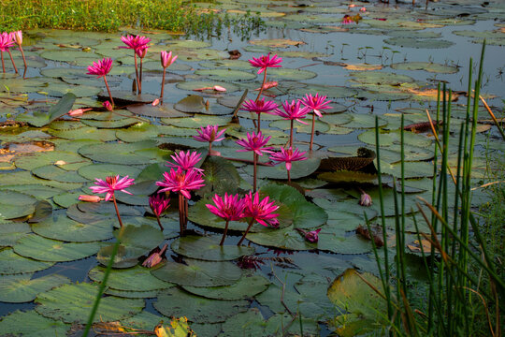

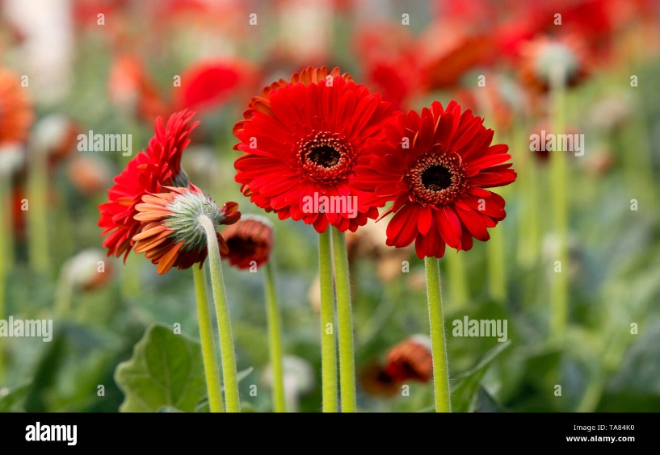
Flowers
Bangladesh is a green country with many flowers. We all love flowers for its beauty and smell. We can't find any person who doesn't like flowers. There are various types of flowers in our country and various colors and smells in them. Some flowers are red, Some flowers are pink, some flowers are purple etc. Some flowers have a nice fragrance and some flowers are without a smell. Bangladeshi flowers are Rose, Water Lily, Kamini, Tuberose, Sunflower, Shelly, Palash, Shefali, Marigold, Beli etc.

Slide 7
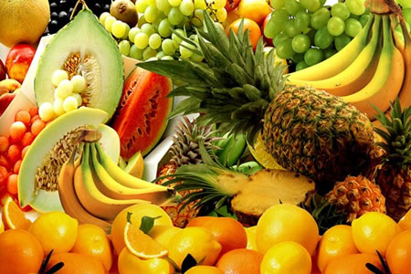
Fruits
The most grown fruits in Bangladesh are mango, jackfruit, blackberry, pineapple, banana, litchi, lemon, guava, berry, papaya, tamarind, melon, watermelon, cashew nut, palmyra, and blueberry

Slide 8
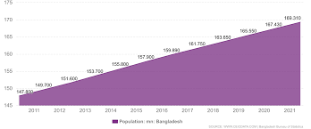
Population
In 1900 the population of Bangladesh was around 29 million people. By 1950 it had grown only slightly to 38 million. But then things changed. Between 1950 and 2000 the population of Bangladesh increased with 92 million people to 130 million corresponding to a 341 percent increase. From 2000 to 2020 the population has increased with an additional 35 million people to 164 million.

Slide 9
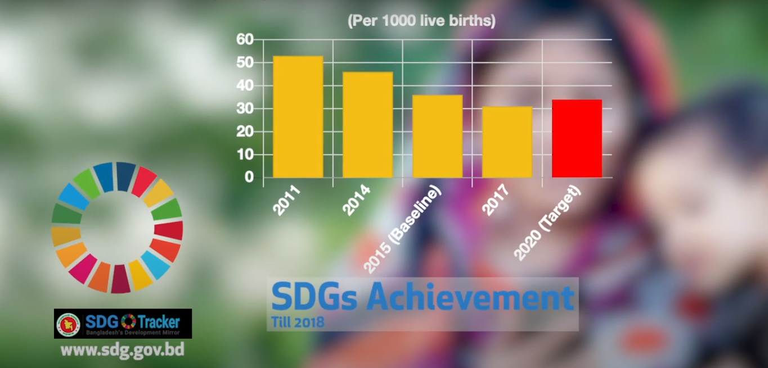
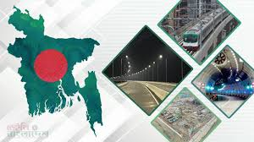
Development
B
In the 40 years since its birth from ashes and fire, Bangladesh has registered many gains. In terms of Millennium Development Goals, Bangladesh has achieved remarkable progress in the areas of primary schooling, lowering the infant and under-five mortality rate and overall poverty reduction.

Slide 10

THANK YOU

